Slide 1
COS 326 Database Systems
Lecture 10
Semi-Structured Data and XML (2)
Chapter 13 (7th edition)
Thursday 22 August 2024

Slide 2
In this lecture
XML Languages
XPath: path expressions
XQuery
Introduction to BaseX
Writing XPath expressions in BaseX
Files available on ClickUP
XML file for this lecture: staff_list.xml

Slide 3
XML Languages
Query language standards
XPath
XQuery
Specifying XPath expressions in XML
Returns sequence of items satisfying certain pattern
Values, elements, or attributes
Qualifier conditions
Separators
Single slash / or double slash //

Slide 4
XML Path Language (XPath)
Declarative query language
Specifying a directory-like path
Possibly with conditions placed in the path
Retrieves collections of elements
Treats XML document as logical tree of nodes
Query component | Description
context node | starting point
location path | path from one point in document to another, composed of steps
step | consists of basis and predicates
basis | axis and node test
axis | direction e.g. grandparent, parent, child, etc.
node test | identifies node type, e.g. element name or function text()
predicate | in square brackets after the basis

Slide 5
XPath query example
basis
axis
node test
Details of 1st staff member?
child::STAFF[1] or /child::STAFF[position()=1]
predicate
Component | Description
context node | starting point in a document
location path | path from one point in document to another, composed of steps /
step | consists of basis and predicates
basis | axis and node test
axis | direction e.g. grandparent, parent, child etc.
node test | identifies node type, e.g. element name or function text()
predicate | in square brackets after the basis
© Pearson Education Limited 1995, 2005

Slide 6
Location path | Selects…
. | …context node
.. | …parent of context node
/ | …root node, or separator between steps in path
// | …descendants of current node
/child::STAFF or /STAFF | …STAFF elements that are children of the root
child::STAFF or STAFF | …STAFF element children of context node
attribute::branchNo or @branchNo | …branchNo attribute of context node
attribute::* or @* | …all attributes of context node
child::STAFF[3] | …third STAFF element that is a child of the context node
/child::STAFF[@branchNo=“B005”] | …STAFF elements that have attribute branchNo with value B005
/child::STAFF[@branchNo=“B005”] [position()=1] | …first STAFF elements that have attribute branchNo with value B005

Slide 7
XPath: path expressions
Details of all staff? //STAFFLIST/child::STAFF or //STAFFLIST/STAFF
STAFFLIST
STAFF
STAFF
STAFFNO
NAME
POSITION
DOB
SALARY
FNAME
LNAME

Slide 8
XPath: path expressions
Details of 1st staff?
//STAFFLIST/child::STAFF[1] or //STAFFLIST/STAFF[1] or
//STAFFLIST/child::STAFF[position()=1]
STAFFLIST
STAFF
STAFF
STAFFNO
NAME
POSITION
DOB
SALARY
FNAME
LNAME
8

Slide 9
XPath: path expressions Staff number of 1st staff?
//STAFFLIST/STAFF[1]/STAFFNO
STAFFLIST
STAFF
STAFF
STAFFNO
NAME
POSITION
DOB
SALARY
FNAME
LNAME

Slide 10
XPath: path expressions
name of 1st staff?
//STAFFLIST/STAFF[1]/NAME
STAFFLIST
STAFF
STAFF
STAFFNO
NAME
POSITION
DOB
SALARY
FNAME
LNAME

Slide 11
XML Query Languages
XML Query language
XML-QL, UnQL, XQL, XQuery, …
XQuery by W3C XML Query Working Group
Contributions from
database community
document community
programming language community
Note: SQL not good for XML (irregularity of XML data)
© Pearson Education Limited 1995, 2005

Slide 12
XQuery
XQuery
a functional language
Meaning: a query is represented as an expression
nested expressions possible
XQuery uses
Path expressions (use the syntax of XPath)
FLWOR expressions
The queries
operate on single documents
operate also on fixed collections of documents
select sub-trees of documents
© Pearson Education Limited 1995, 2005

Slide 13
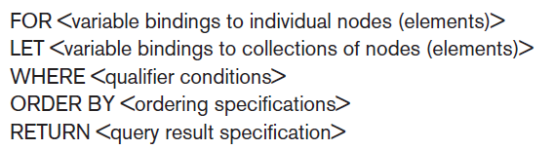
XQuery: Specifying Queries in XML
FLWOR expression
Variables preceded with $
For assigns variable to a range
Where specifies additional conditions
Order by specifies order of result elements
Return specifies elements for retrieval

Slide 14
Introduction to BaseX
BaseX is an open source robust, high-performance XML database engine.
It was created by Christian Grün in 2005 at the University of Konstanz in Germany.
It is specialised in storing, querying, and visualizing large XML documents and collections
It serves as excellent framework for building complex data-intensive web applications.
It comes with interactive user interfaces (desktop, web-based) giving great insight into semi-structured data.
Supports both the XPath and XQuery languages.
© Pearson Education Limited 1995, 2005

Slide 15
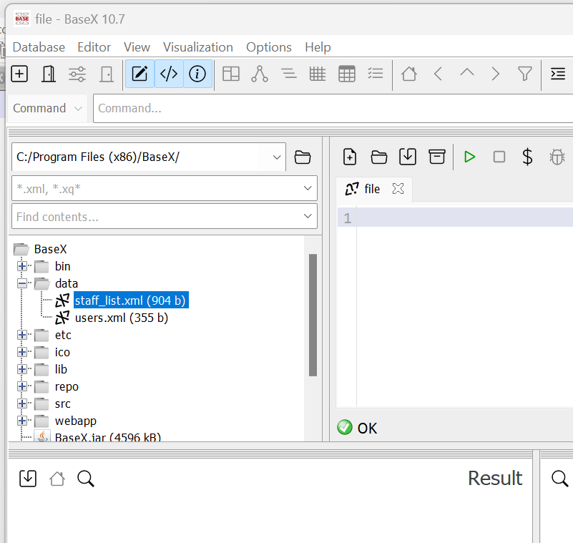
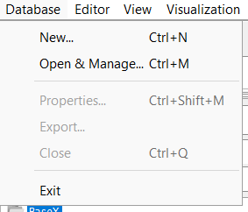
BaseX 11.2 – DBMS for XML data (1)
Database menu
(1) Navigate to the Data folder under C:\Program Files (x86) \BaseX & copy your XML files to this folder. Then open BaseX
(2) To create a new DB
Click on Database | New.
Then type in the database name
and then click on OK.

Slide 16
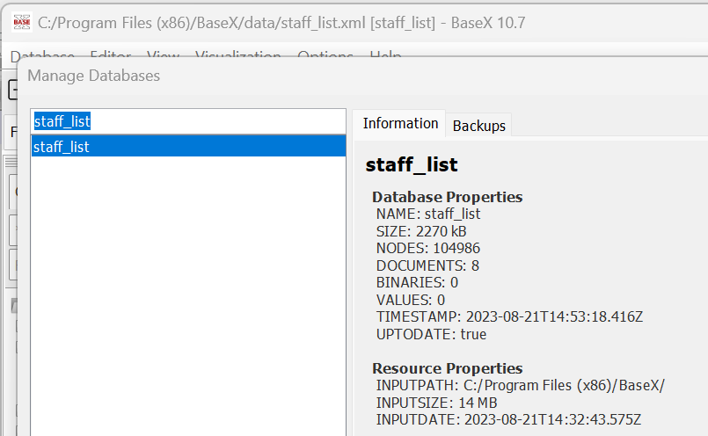
BaseX 11.2 – DBMS for XML data (2)
To open an existing DB in the folder data (or other name)
Click on Database | Open & Manage...
Then click on the database name, e.g. Data and then click on Open.

Slide 17
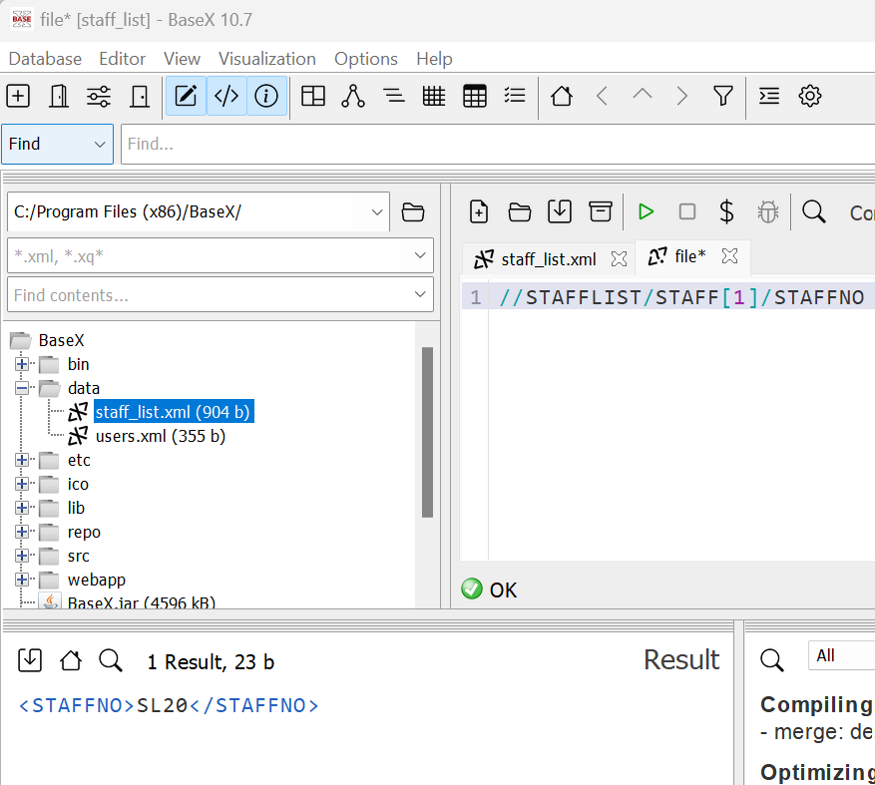
BaseX 11.2 – DBMS for XML data (3)
e.g. Query: //STAFFLIST/STAFF[1]/STAFFNO
1. Type a query in Query Editor
2. Click on Execute query button
3. Query results pane

Slide 18
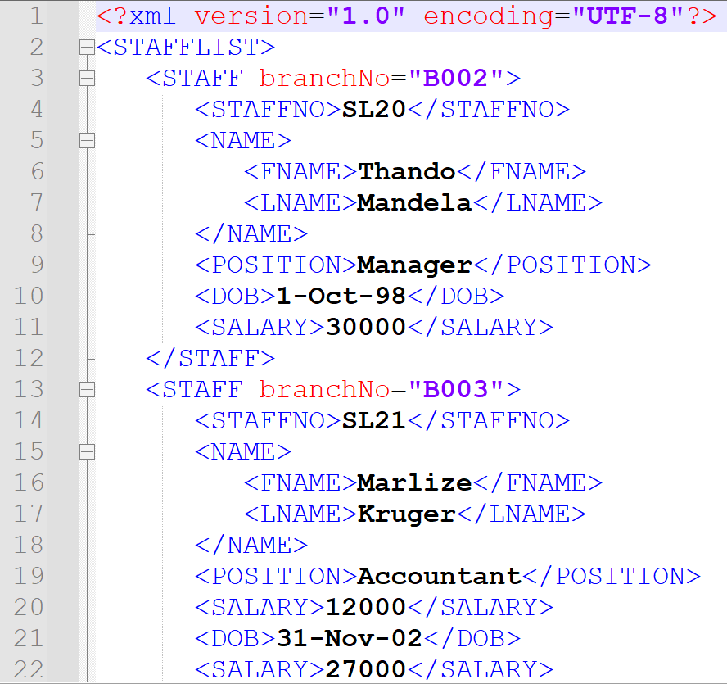
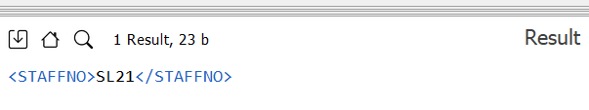
Find staff number of first member of staff in staff_list.xml
Query: //STAFFLIST/STAFF[1]/STAFFNO

Slide 19
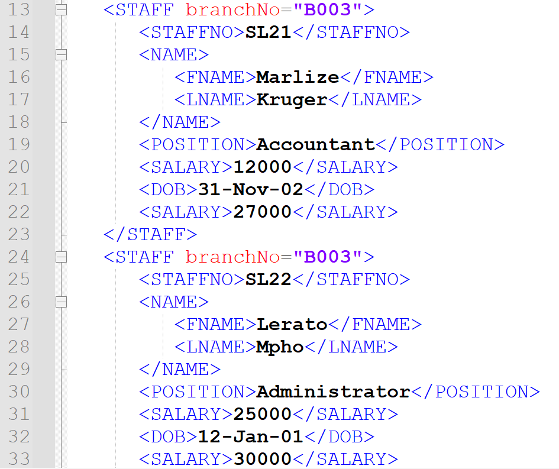
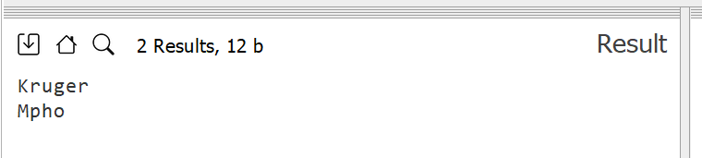
Find the last names for staff at branch B003
Query: //STAFFLIST/STAFF[@branchNo="B003"]/NAME/LNAME/text()

Slide 20
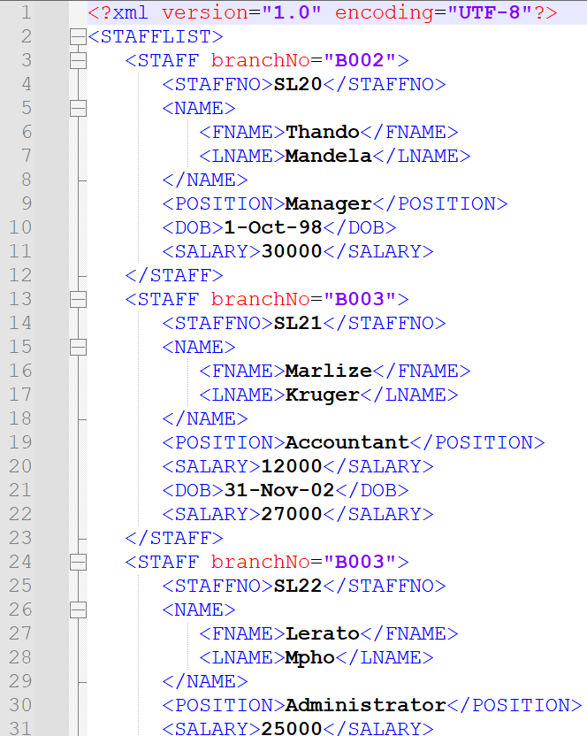
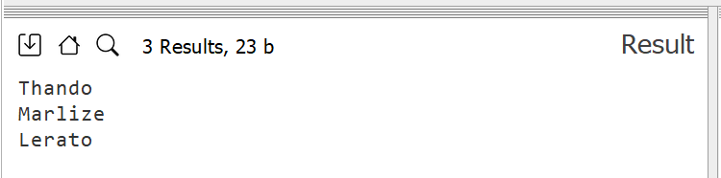
Find the first names for all staff
Query: //STAFFLIST/STAFF/NAME/FNAME/text()

